Slide 1
WHATSAPP CHAT ANALYZER
PRETI SHERINE P(210701195)
YUVAMALINI M(210701507)

Slide 2

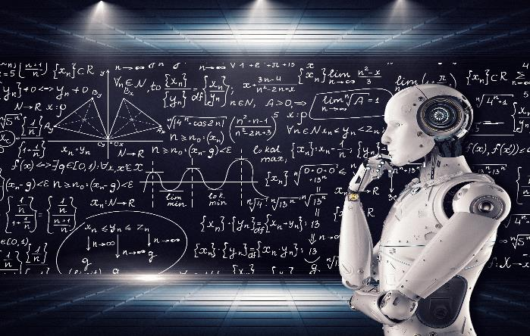
INTRODUCTION
IN AN ERA DOMINATED BY DIGITAL COMMUNICATION,WHATSAPP HAS EMERGED AS A PRIMARY PLATFORMFOR EXCHANGING MESSAGES AND MEDIA.THE WHATSAPP CHAT ANALYZER HELPS US IN UNDERSTANDING OUR CONVERSATION IN THE PLATFORM.IT CRUNCHES OUR DATA INTO EASY TO DIGEST INSIGHTS SUCH AS HOW MANY MESSAGES WE HAVE SEND , OUR BUSIEST DAY AND SO ON. IT IS A SIMPLE WAY TO MAKE SENSE OF OUR CHAT AND IMPROVE OUR COMMUNICATION GAME

Slide 3
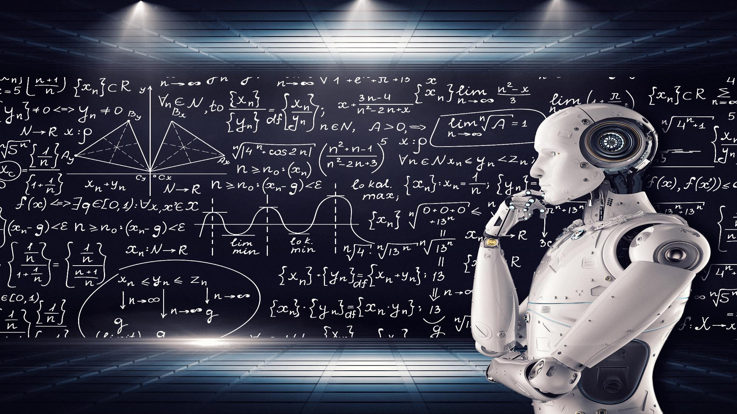
INTRODUCTION
IN AN ERA DOMINATED BY DIGITAL COMMUNICATION,WHATSAPP HAS EMERGED AS A PRIMARY PLATFORMFOR EXCHANGING MESSAGES AND MEDIA.THE WHATSAPP CHAT ANALYZER HELPS US IN UNDERSTANDING OUR CONVERSATION IN THE PLATFORM.IT CRUNCHES OUR DATA INTO EASY TO DIGEST INSIGHTS SUCH AS HOW MANY MESSAGES WE HAVE SEND , OUR BUSIEST DAY AND SO ON. IT IS A SIMPLE WAY TO MAKE SENSE OF OUR CHAT AND IMPROVE OUR COMMUNICATION GAME

Slide 4
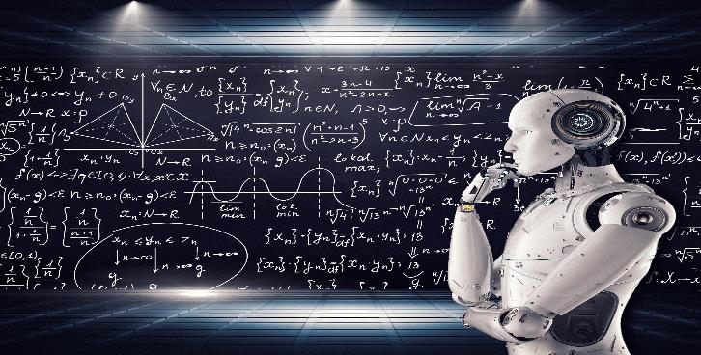
WHY WHATSAPP CHAT ANALYZER
ENHANCED COMMUNICATION UNDERSTANDING
ACTIVITY PEAK
CONTENT ANALYSIS

Slide 5

WHY WHATSAPP CHAT ANALYZER
ENHANCED COMMUNICATION UNDERSTANDING
ACTIVITY PEAK
CONTENT ANALYSIS

Slide 6
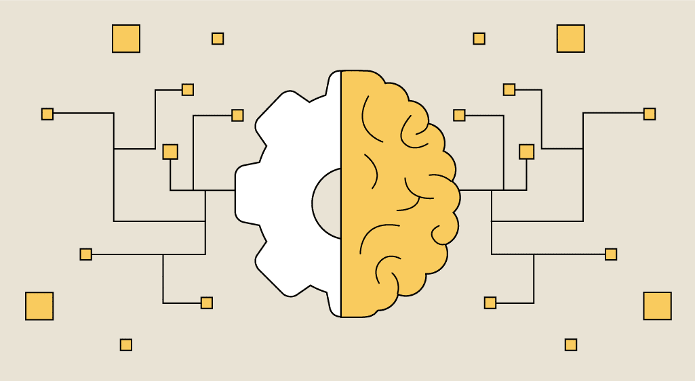
LIBRARIES USED

Slide 7

LIBRARIES USED
1)STREAMLIT
2)MATPLOTLIB
3)PLOTY.EXPRESS
4)SEABORN
5)URL EXTRACT
6)WORDCLOUD
7)COUNTER
8)REGEX

Slide 8
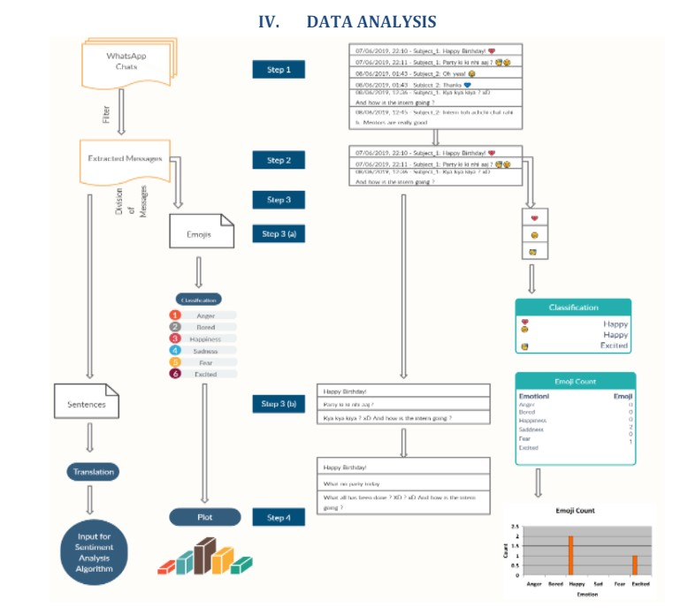
FLOW DIAGRAM

Slide 9
RESULT

Slide 10
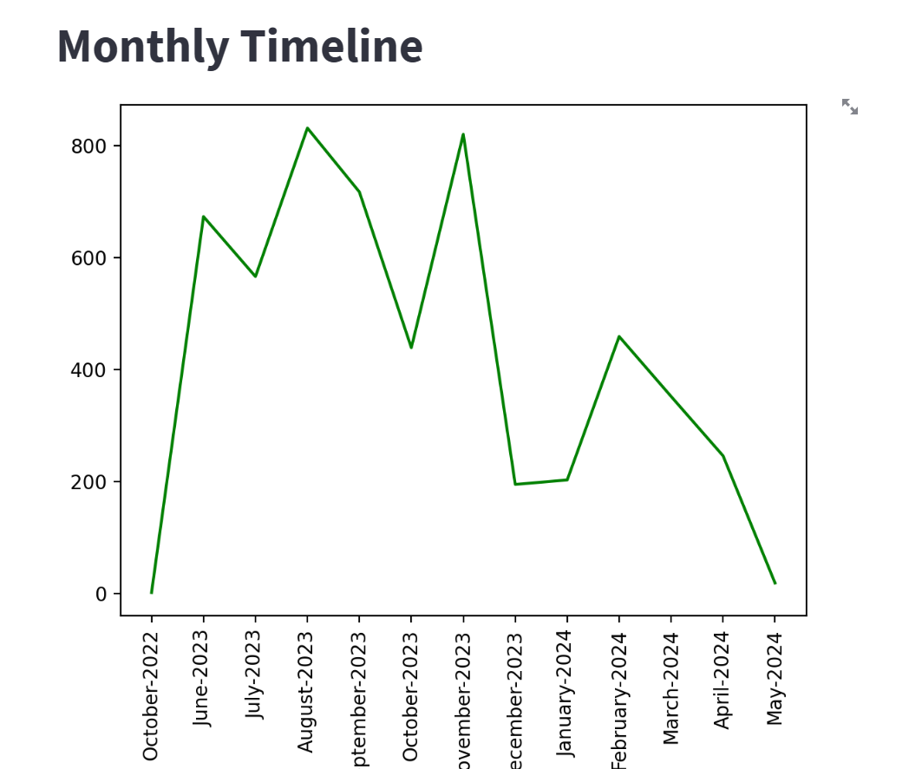
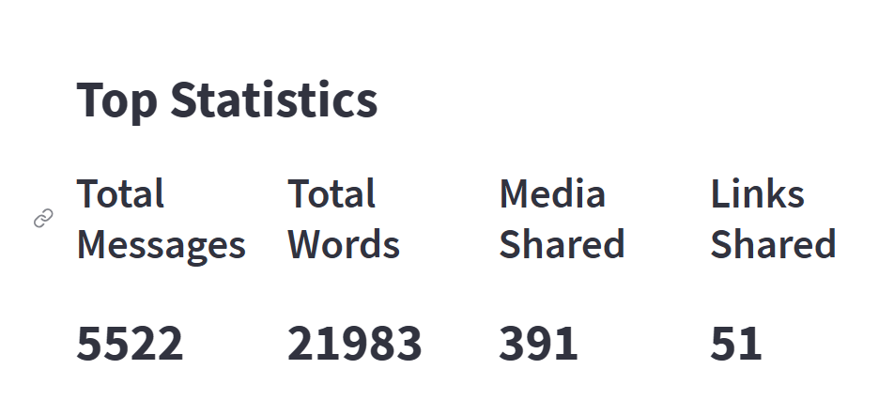
1)TOP STATISTICS
2)MONTHLY TIMELINE

Slide 11
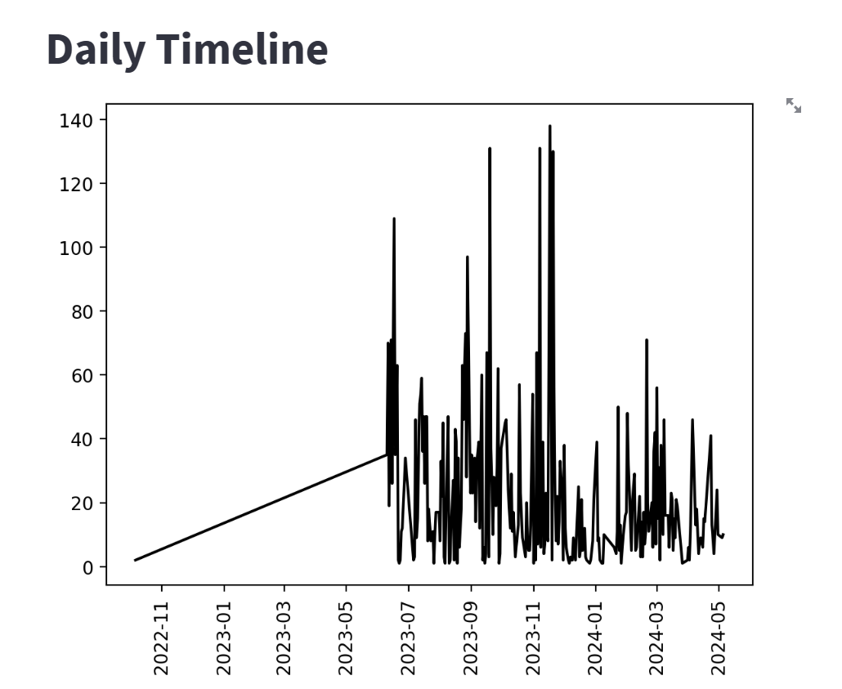
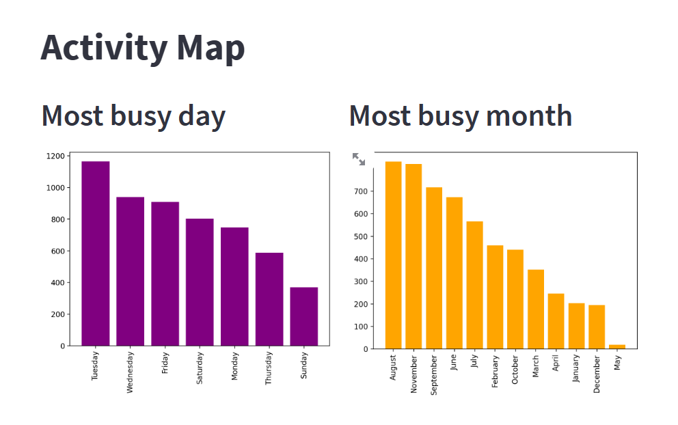
3)DAILY TIMELINE
4)ACTIVITY MAP

Slide 12
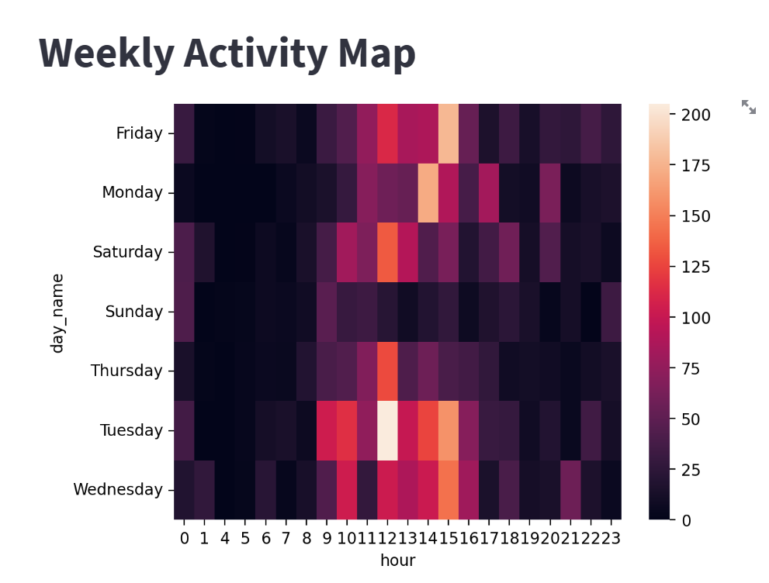
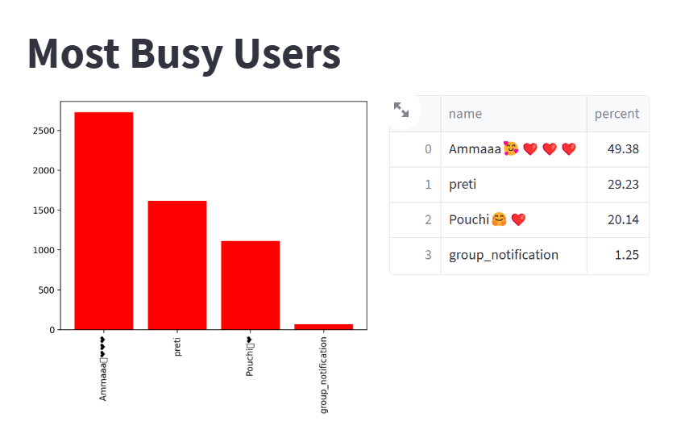
5)WEEKLY ACTIVITY MAP
6)MOST BUSY USERS

Slide 13
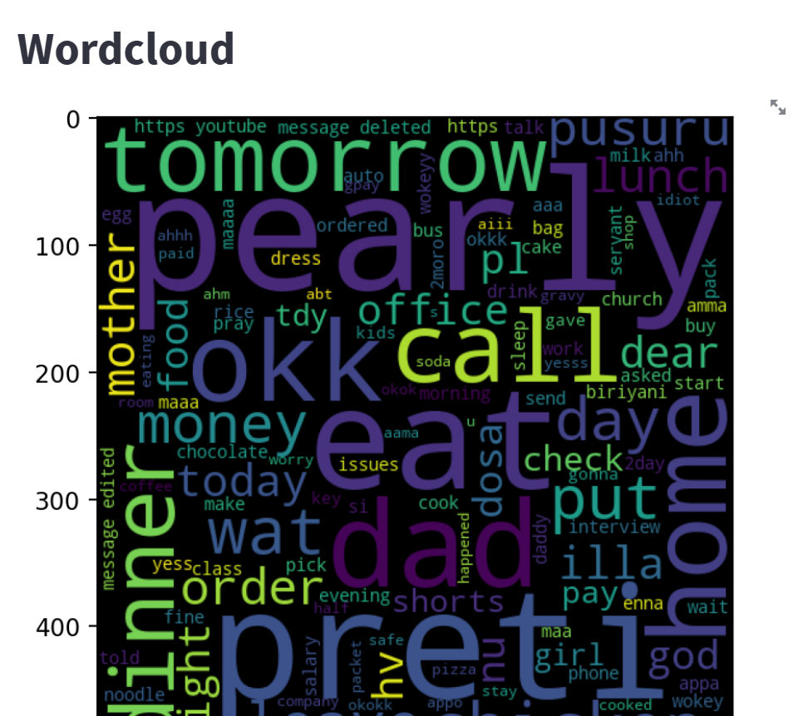
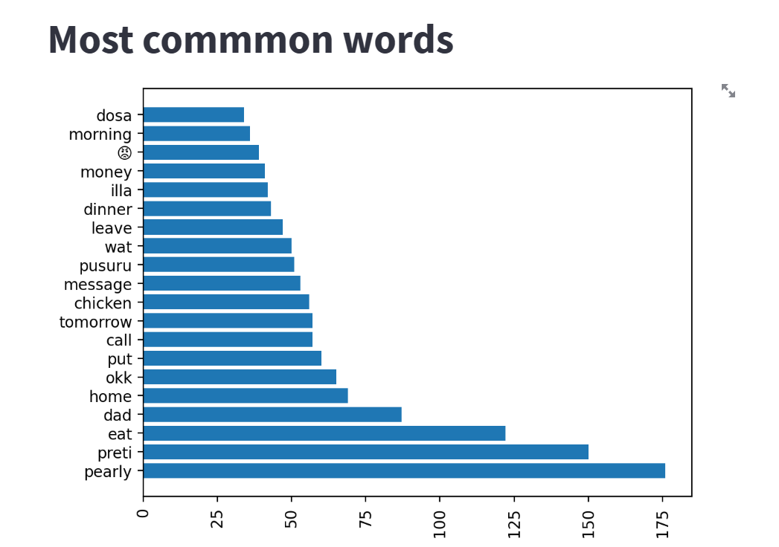
7)WORDCLOUD
8)MOST COMMON WORDS

Slide 14
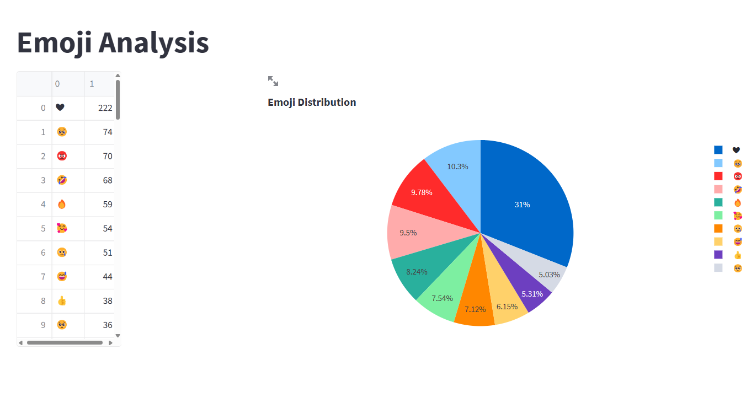
9)EMOJI ANALYSIS

Slide 15
5
4
IMPROVES COMMUNICATION
USER FRIENDLY
USER ENGAGEMENT
TRANSFORMS CHAT DATA
3
MESSAGE METRICS
CONCLUSION
2
1

Slide 16
5
4
IMPROVES COMMUNICATION
USER FRIENDLY
USER ENGAGEMENT
TRANSFORMS CHAT DATA
3
MESSAGE METRICS
2
1

Slide 17
5
4
IMPROVES COMMUNICATION
USER FRIENDLY
USER ENGAGEMENT
TRANSFORMS CHAT DATA
3
MESSAGE METRICS
2
1

Slide 18
5
4
IMPROVES COMMUNICATION
USER FRIENDLY
USER ENGAGEMENT
3
TRANSFORMS CHAT DATA
MESSAGE METRICS
2
1

Slide 19
5
4
IMPROVES COMMUNICATION
USER FRIENDLY
USER ENGAGEMENT
3
TRANSFORMS CHAT DATA
MESSAGE METRICS
2
1

Slide 20
5
4
IMPROVES COMMUNICATION
USER FRIENDLY
USER ENGAGEMENT
3
TRANSFORMS CHAT DATA
MESSAGE METRICS
2
1

Slide 21
THANK YOU
!!!!!!

